Slide 1
Preliminary Design Review (GNC)
Martin Kamme Contributions

Slide 2
Introduction
This presentation summarizes some of my contributions to the Cal Poly SLO Astronautics Senior Design class of 2020
All the following work is my own EXCEPT the CONOPS slides 4 and 5. These are necessary to understand my contributions to the overall design. Credit to the owner is given on those slides.
The RFP that we designed our system for is included in the github repository
Please reach out to me with any questions! martinkamme@gmail.com
Martin Kamme

Slide 3
Acronyms
COLONEE – Constellation Operations for Lunar Outpost and New Extraterrestrial Endeavors
ConOps – Concept of Operations
EOL – End of life
GNC – Guidance Navigation and Control
LCV – Lunar Capture Vehicle
LSS – Lunar Support Satellite
LV – Launch Vehicle
RAAN – Right Ascension of Ascending Node
RFP – Request for Proposal
RSW – Radial Along-Track Cross-Track
SOI – Sphere of Influence
STK – Satellite Toolkit
UTCG – Coordinated Universal Time in Gregorian Format
Martin Kamme

Slide 4
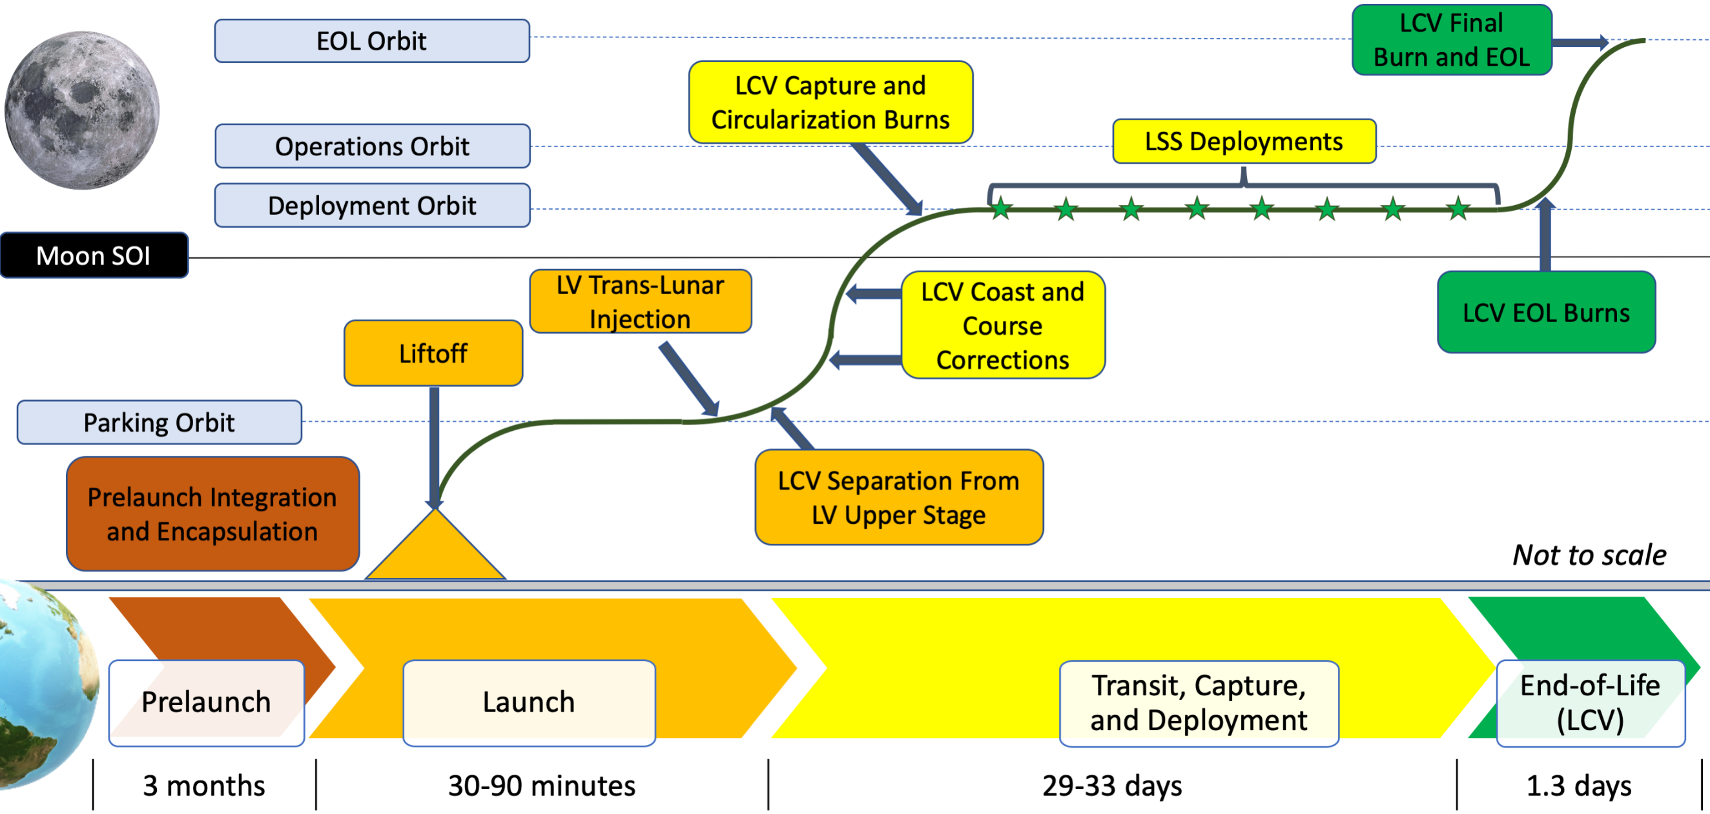
CONOPS: Prelaunch to LCV EOL
Sean Nogrady
Notes:
RFA: Time scale was added to satisfied PM_4. CONOPS diagram only includes CONOPS of one launch, but then

Slide 5
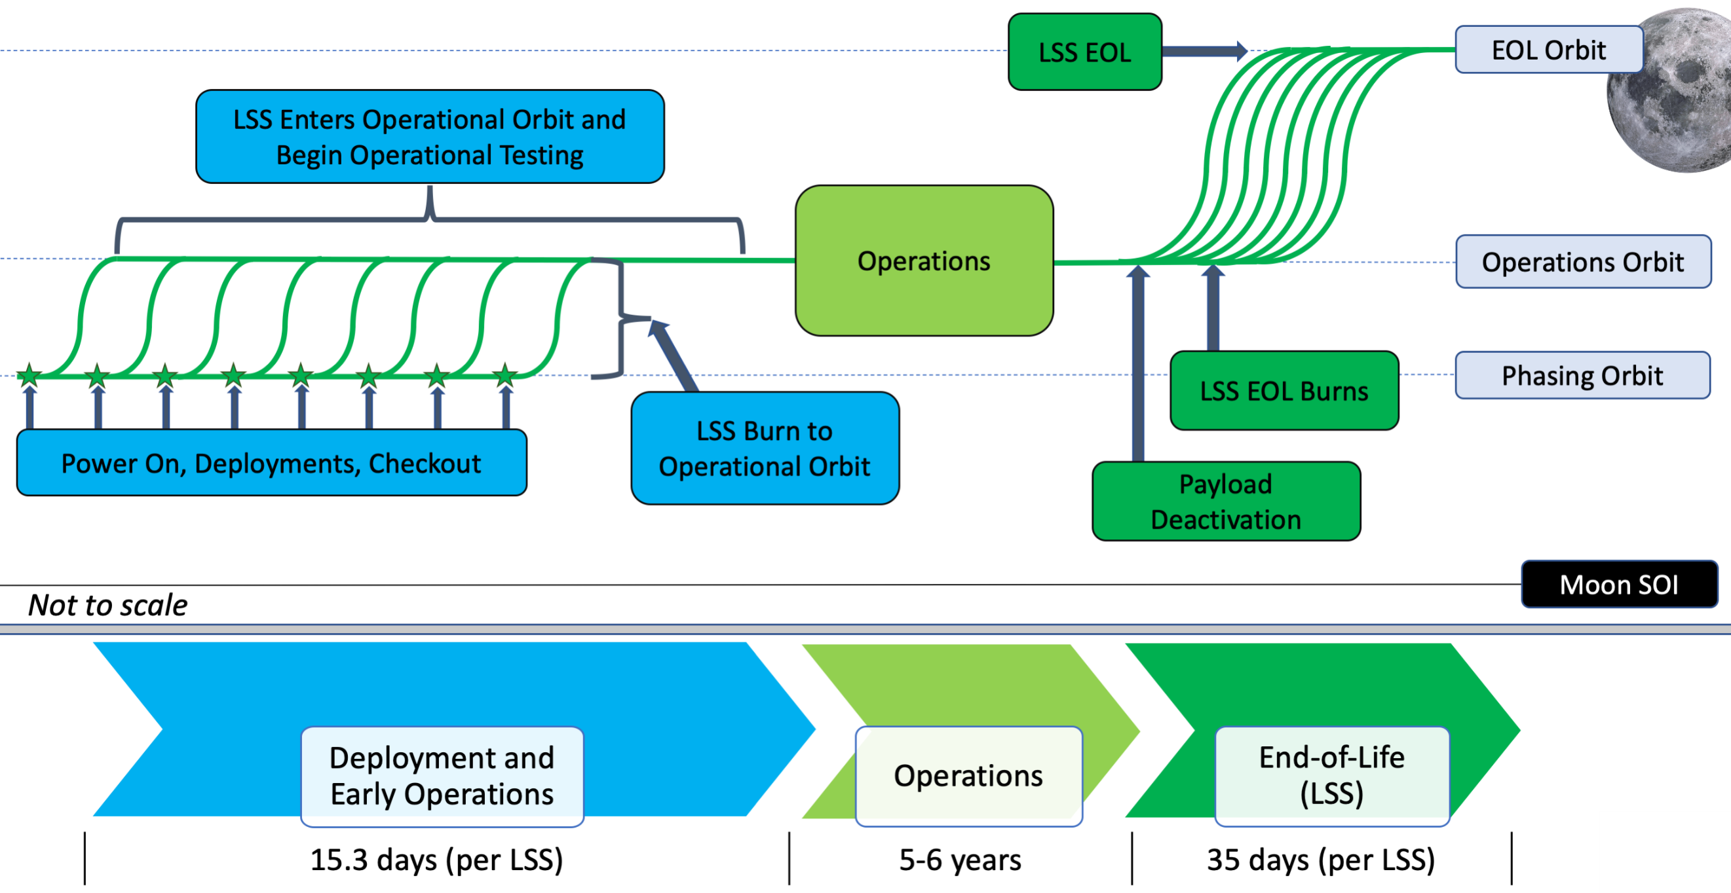
CONOPS: Deployment and Early Operations to LSS EOL
Sean Nogrady

Slide 6
Constellation Design

Slide 7
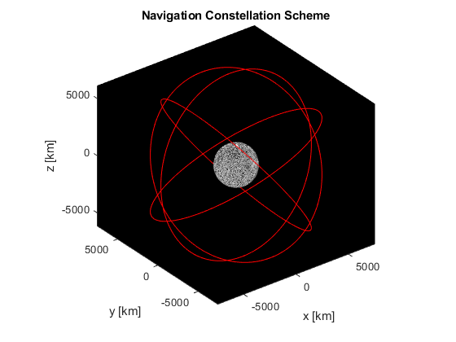
Constellation Design
Led preliminary design of the Lunar Navigation Constellation
Designed 4 plane walker delta constellation with 28 satellites to meet the global and continuous navigation requirements outlined in the RFP
Final constellation and analysis completed by other GNC members
Martin Kamme

Slide 8
Transfer Design

Slide 9
Transfer Design
LV will provide TLI burn for the LCVs Direct Transfer to the moon
Two correctional burns along trajectory
LCV will perform capture burn at perigee of ecc = 0.6 and rp = 7380 km capture orbit
Each launch will place one LCV in one of the four operational orbits
Transfer trajectory is designed around the desired arrival geometry about the moon inertial axes:
Perilune radius: 7380 km
Ecc: 0.6
Inc: 50 degrees
RAAN: 0, 90, 180, or 270 (depending on Launch Number)
The trajectories for each launch were designed using a series of Target Sequences with multiple Differential Correctors in STK
Martin Kamme
Notes:
The most crucial target sequence in the STK simulation with regards to designing the transfer trajectory was the first target sequence that targeted:
Lunar Declination and Lunar Right Ascension,
BdotT and BdotR,
lunar inclination, perilune, and lunar RAAN.
These properties were targeted in the order in which they are mentioned. STK was setup to iterate the Launch Date and Time In Parking Orbit to meet each of the properties.

Slide 10
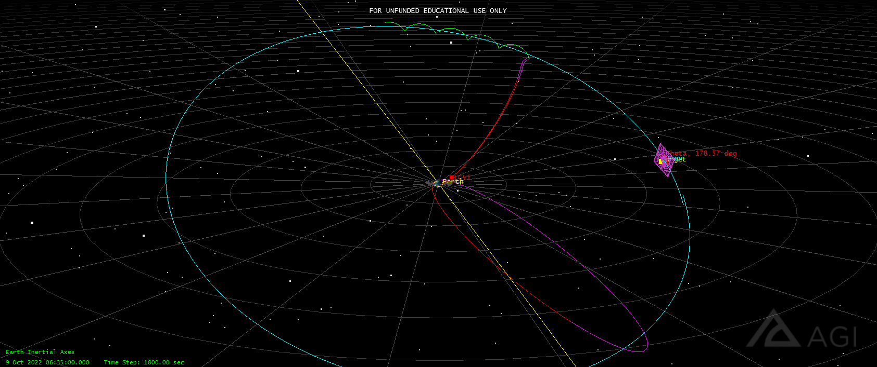
Transfer Design – LCV 1 (Earth Centered View)
Martin Kamme
Notes:
The purple plane intersecting the moon is the Bplane which includes the BdotT and BdoR vectors that are targeted in the first STK Target Sequence
The image contains a couple trajectories that were thrown out because they didn’t meet the constraints
The chosen trajectory for this LCV1 is the one that connects with the green lines which are the earth view of the LCV orbiting the Moon

Slide 11
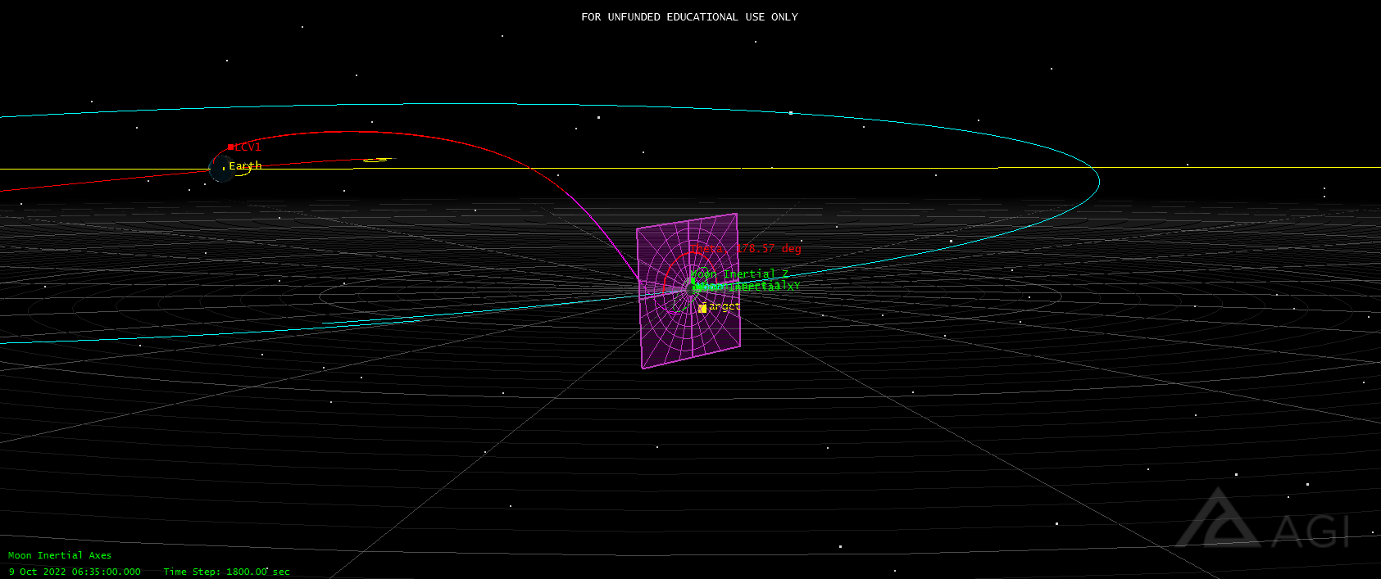
Transfer Design – LCV 1 (Moon Centered View)
Maritn Kamme
Notes:
This image shows the Moon Centered View of the transfer trajectory to the moon
Again, this image contains the Bplane that was mentioned in the previous slide
All the targeted lunar orbital elements are with respect to the Moon Inertial Axes, and thus those are also included in the above image
The different colors of the trajectory refer to different parts of the STK Mission Control Sequence
Red begins after the TLI burn and ends when the LCV is 300,000 km away from the center of the Earth
Purple begins immediately after the red ends and continues up until the capture burn location about the moon
There is no plot of the elliptic capture orbit about the moon, the green orbit is the circular deployment orbit of LCV

Slide 12
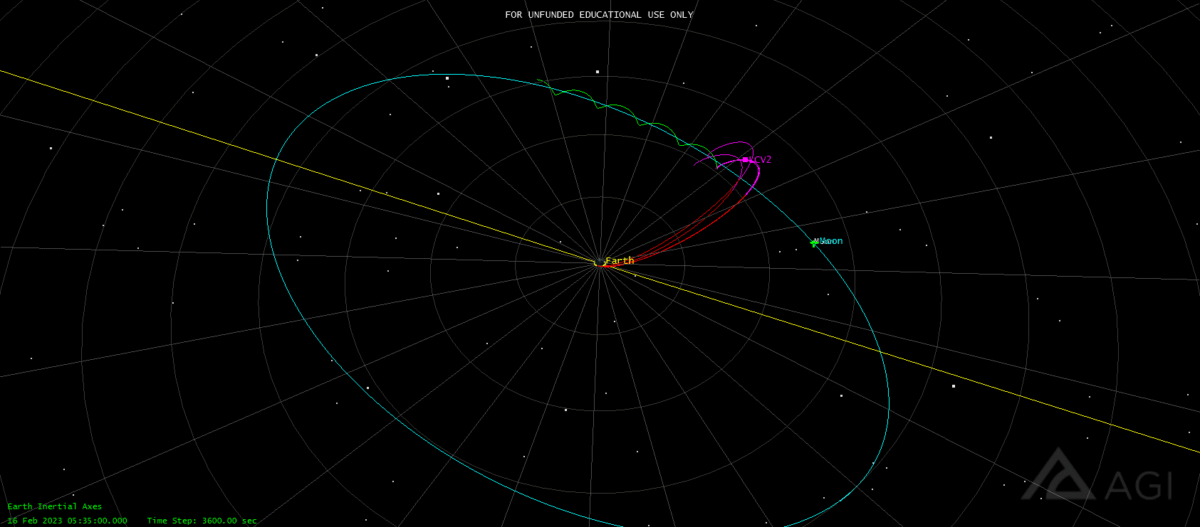
Transfer Design – LCV 2 (Earth Centered)
Martin Kamme
Notes:
Here is another Earth centered view but of LCV 2’s trajectory instead. LCV 2,3, and 4 will all have similar trajectories that swing beyond the location of the moon before they return to intercept the moon
This will be explained in a later slide

Slide 13
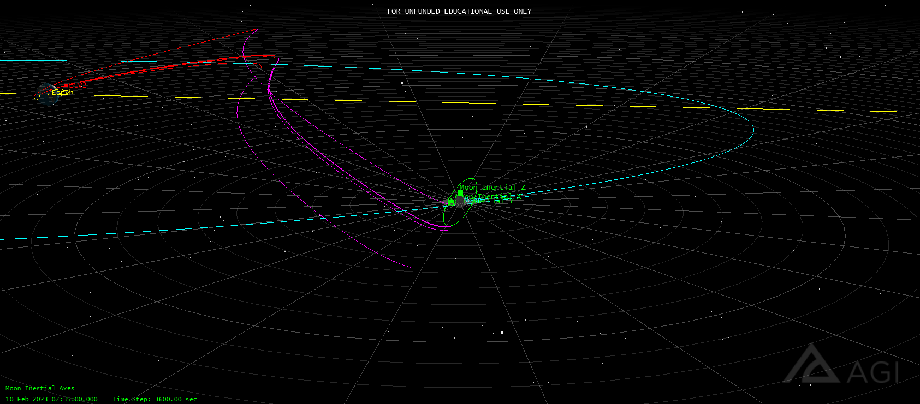
Transfer Design – LCV 2 (Moon centered)
Martin Kamme
Notes:
The moon centered view of LCV 2’s trajectory is also illustrative of the path that LCVs 3 and 4 will take.
The colors all have the same correlation as was mentioned in the Moon Centered view of LCV 1

Slide 14
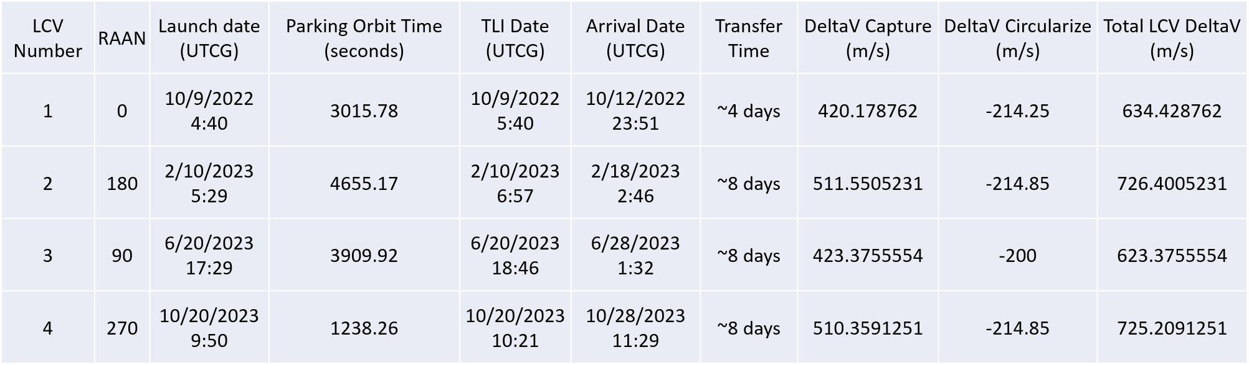
Launch Dates
Choosing a launch date:
Each launch planned so that the arrival geometry most closely matches the RAAN of the targeted operational orbit
Launch windows handed to GNC team by Program Management and launch dates for each LCV were chose to fit into those dates
Martin Kamme
Notes:
The table presents the important data coupled with each of the launch dates
Note that the time in parking orbit ranges from 1000 second to almost 5000 seconds
The parking orbit is a circular orbit at an altitude of 300 km
There is one opportunity for the TLI burn for each of the launches
The reason for the differences in the transfer time is explained in the following slide
Again, the targeted RAAN was the driving factor of each of the launch dates and is thus the only orbital parameter that is included in the table
As mentioned earlier, a 55 degree inclination and radius of perilune of 7380 km were also targeted during the trajectory design

Slide 15
Launch Dates – Trajectory Differences
LCV 1 trajectory takes 4 days while LCV 2-4 trajectories all take 8 days each
Program Management presented programmatic launch windows from which launch dates for RAAN: 0, 90, 180, 270 had to be generated
STK converged to a shorter trajectory (4 days) when targeting the 0 RAAN orbit, this is clear in the preceding Earth Centered Images for LCV 1 and LCV 2
STK converged to longer trajectories (8 days) for the remaining orbits
Martin Kamme
Notes:
To shorten the transfer times it would be necessary to try all combinations of desired RAAN and the Programmatic launch windows.

Slide 16
Correctional Maneuvers
They will occur at two places on the trajectory, each burn taking 4-5 minutes
First one will occur at a time closely following the TLI burn (performed by the LV) and the second one will occur at a later time when the LCV is nearer the moon
Martin Kamme
Notes:
We did not perform any analysis to design the correctional maneuvers for our transfer trajectory. We learned from the Apollo missions that the direct transfer method included a correctional maneuver closely following the TLI burn and another one upon close approach of the moon. We copied this the correctional maneuver design for our direct transfer.

Slide 17
Capture
Upon arrival at the moon, the LCV performs the capture burn at a perilune of 7380 km and captures into an orbit of 0.6 ecc
Upon returning to perigee in the following orbit, the LCV burns again to circularize its orbit
The capture into the LCV deployment orbit is split into a capture and circularization burn because it significantly reduces the requirements (i.e number of thrusters, burn time) placed on the LCV propulsion system
Martin Kamme
Notes:
We initially considered performing the capture and circularization burns simultaneously upon capture into lunar orbit. Splitting the burn into two burns does not reduce the total deltaV requirement, but it significantly lowers the requirements placed on the LCV propulsion system. It lowers the amount of thrusters required and the burn time. The additional lifetime of the LCV (from spending one orbit in the eccentric capture orbit to return to perilune) did not present any problems to the design to the LCV and thus it was decided to split the capture burn into two burns.

Slide 18
LSS Deployment

Slide 19


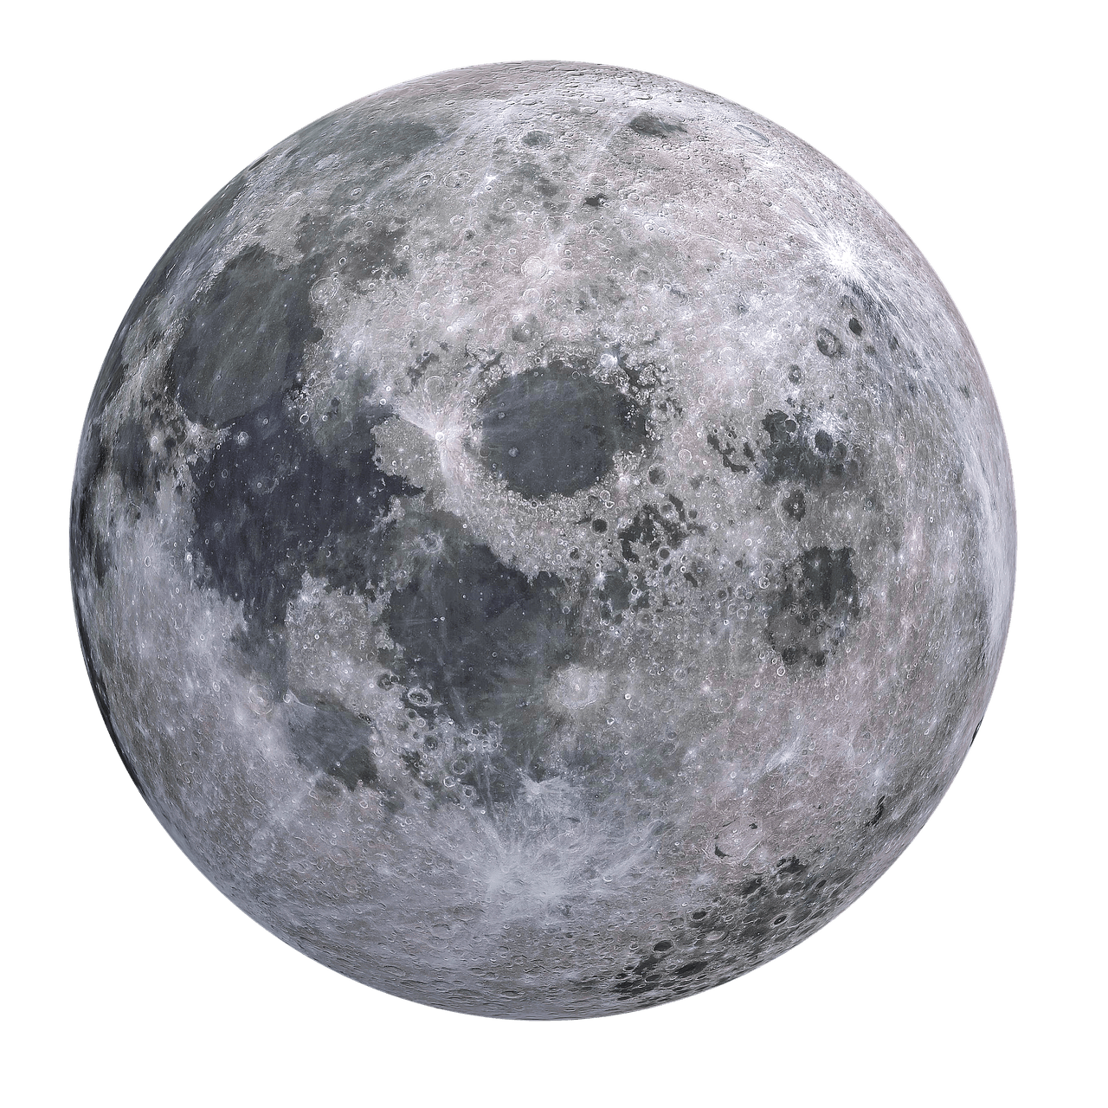
LSS Deployment - ConOps
|
|
|
1
LCV circularizes inner orbit
2
LCV deploys LSS 1
3
LSS 1 coasts time T for checkout and orientation
a = 7380 km
a = 7500 km
|
|
6
|
5
LCV and remaining LSS’s repeat steps 2-5 until LSS 8 is deployed
4
LSS 1 begins non impulsive burn to arrive in operational orbit within time t
LCV waits time t1 (measured from deployment of LSS 1) to deploy LSS 2
Martin Kamme
t ≅ 23.6183 hrs t1 ≅ 82.6371
Notes:
Here is the ConOps of the chosen LSS deployment scheme

Slide 20
LSS Deployment – Timeline
Step° | Δt_{total} | Δt_{step} | LCV Operation
1 | 0 | - | LCV circularizes inner orbit
2 | X⃰ | X | LCV deploys LSS 1
5 | X + t1 | t1 | LCV waits t1 deploy LSS 2
6 | X + 7*t1 | t1 | LCV repeats steps 2-5 for LSS 3-8
Summary
Operation | Time
Orbital Plane is Filled with LSS 1-8 | X + 25.08 days + T hrs
Step | Δt_{total} | Δt_{step} | LSS Operation
3 | X + T | T | LSS 1 coasts
4 | X + T + t | t | LSS 1 burns into operational orbit
5 | X + T+ t + 7*t1 | t (each) | LSS 2-8 burn into operational orbit
°Step number corresponds to ConOps numbering
⃰ X≅ 0 (If first LCV to arrive at Moon) + some LCV checkout time
t ≅ 23.6183 hrs t1 ≅ 82.6371 hrs
Martin Kamme
Notes:
The tables above contain the timeline for the deployment of the constellation and are enumerated with numbers matching those in the ConOps in the previous slide
Time t is the time it take for one LSS to constantly burn from the LCV deployment orbit to the LSS operational orbit
Time t1 is the time that the LCV waits in between deployments of each LSS
Time T is included to cover time dedicated to checkout/orientation or any anomaly that happens during deployment
Time X is checkout of the LCV after circularizing its deployment orbit and some additional time depending on the positions of the satellites already located in the lunar constellation
It will take 25 days plus time X and time T to place all the LSS of one plane into their operational orbit

Slide 21
LSS Deployment – Reasoning
Deployment scheme uses: differences in mean motion of LCV deployment orbit and LSS operational orbit, and the time it takes for LSS to constantly burn into operational orbit to ensure that the LSS are spaced by 45 degrees in argument of latitude in operational orbit
Better than alternatives because:
Flexible to anomalies in all phases of deployment
Avoids primer vector theory analysis
Limits deltaV requirements and complexity of the LCV
Limits collision risk
Large tolerances on required orbital parameters
Martin Kamme
Notes:
We considered a number of other deployment alternatives. One scheme had the LCV in an eccentric deployment whose apogee coincided with the radius of the operational orbit and the period matched the time between each LSS in the operational orbit. We scrubbed this idea because it required primer vector theory since the LSS cannot perform impulsive burns and the design was very sensitive to the LCV deployment orbit and anomalies in any phase of the deployment. We also considered a similar scheme that included the deployment of multiple LSS simultaneously but this significantly increased the risk of satellite collision. Finally, we considered a deployment scheme where the LCV would burn off and on its operational orbit, using the period of its deployment orbit, to deploy each LSS into place in the LSS operational orbit. We scrubbed this idea because it became incredibly complex very quickly and required very tight tolerances throughout every phase of deployment, thus becoming sensitive to any anomalies.

Slide 22
LSS Deployment – LCV Spin
LCV will spin during deployment at a max velocity of 1 rpm
Analyze how releasing LSS at any angle from horizontal (0-360) will affect the final orbital parameters of the LSS as it reaches it operational altitude
Martin Kamme

Slide 23
LSS Deployment – LCV Spin (Analysis Setup)
Legend:
Θ - Angle from R axis in RSW system. Rotating through theta tests all the possible directions of LSS release if LCV is spinning.
-Velocity of releasing from spinning LCV
- Velocity of LCV
- LCV
- LSS
Θ
View: Above Orbital Plane
View: Parallel to Orbital Plane
Martin Kamme

Slide 24
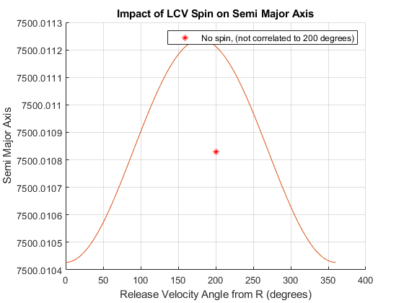
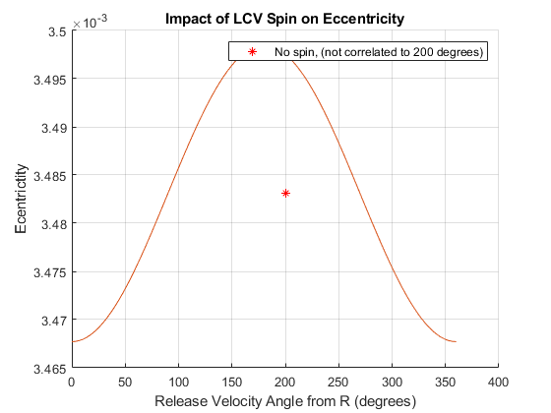
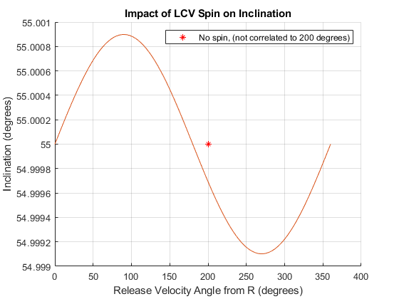
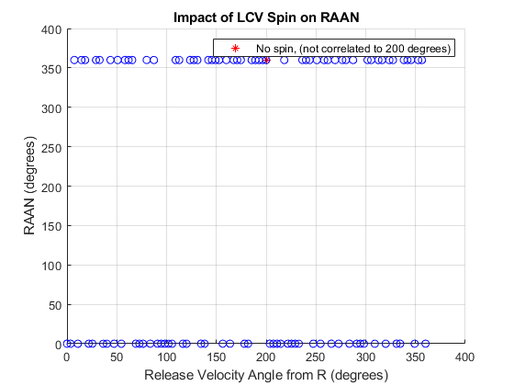
LSS Deployment – LCV Spin (Results)
Releasing the LSS at any angle while the LCV is spinning does not significantly affect the final LSS operational orbital parameters
Martin Kamme

Slide 25
LSS Deployment – Collision Risk
Deploy one LSS at a time
The spin of the LCV and deployment mechanisms generates some relative velocity between the LSS and LCV, but the LSS will return to the LCV within one period of the deployment orbit
This means that the LSS will begin its burn into operational orbit half a period after it has been deployed from the LCV
An LSS that is burning into operational orbit will not collide with another LSS that is burning into operational orbit because an LSS will always reach its operational altitude before the next LSS is deployed
Martin Kamme

